Slide 1
Womanium Quantum + AI Program 2024
Development of Novel Quantum Algorithms
Verifiability of Quantumness – Evidence for The Utility of Quantum Computing Before Fault Tolerance – Quantum Portfolio Optimization
Leveraging Quantum Computing for Financial Optimization
Group name. Noise Nullifiers
Nigel Phillips(USA), Kazim Mumtaz(Pakistan), Tulsi Chaudhari(USA)
Notes:
"Welcome everyone to our presentation on the Development of Novel Quantum Algorithms. We are part of the Womanium Quantum + AI Program 2024. Our project focuses on the verifiability of quantumness, evidence for the utility of quantum computing before fault tolerance, and quantum portfolio optimization. Our team, Noise Nullifiers, consists of Nigel Phillips from the USA, Kazim Mumtaz from Pakistan, and Tulsi Chaudhari from the USA."

Slide 2
INTRODUCTION
Objective: To leverage quantum computing for optimizing financial portfolios using real-world data.
Overview: This project explores the application of quantum algorithms to enhance the efficiency and scalability of financial optimization tasks.
Notes:
"Our objective is to leverage quantum computing for optimizing financial portfolios using real-world data. This project explores the application of quantum algorithms to enhance the efficiency and scalability of financial optimization tasks."

Slide 3
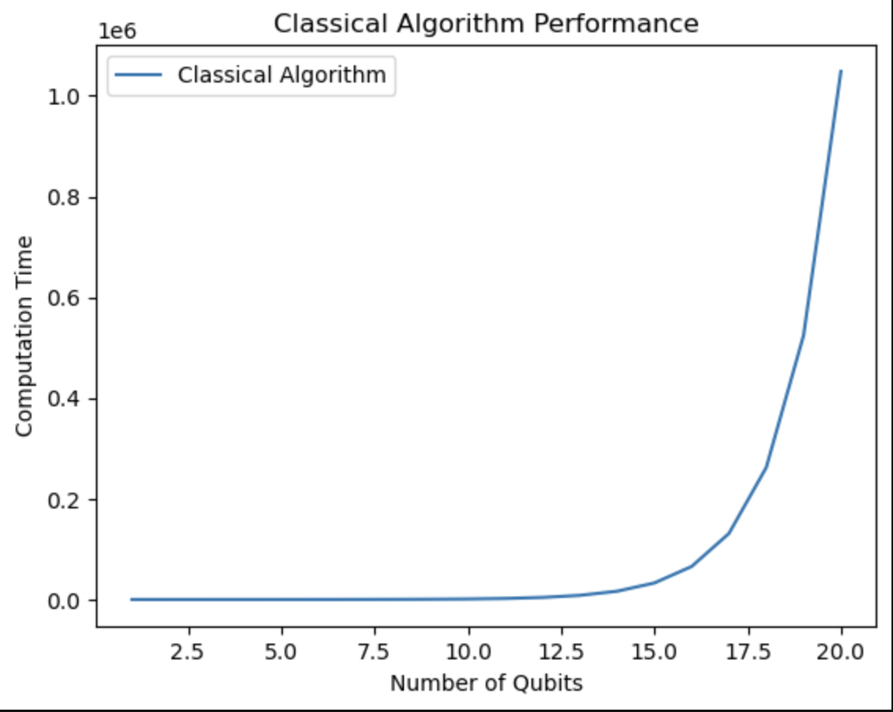
Classical Algorithm Performance Visualization
Description:
This histogram displays the performance of Deutsch-Joza’s
algorithm simulation as it measures 20 bits, later to be called qubits.
Goal:
Illustrates the potential of quantum algorithms to
provide more efficient solutions compared to classical
methods based on computational times.
Notes:
"This histogram displays the results of a Deutsch-Joza’s algorithm simulation using Qiskit, showcasing the frequency of different outcomes. The goal is to illustrate the potential of quantum algorithms to provide more efficient solutions compared to classical methods."

Slide 4
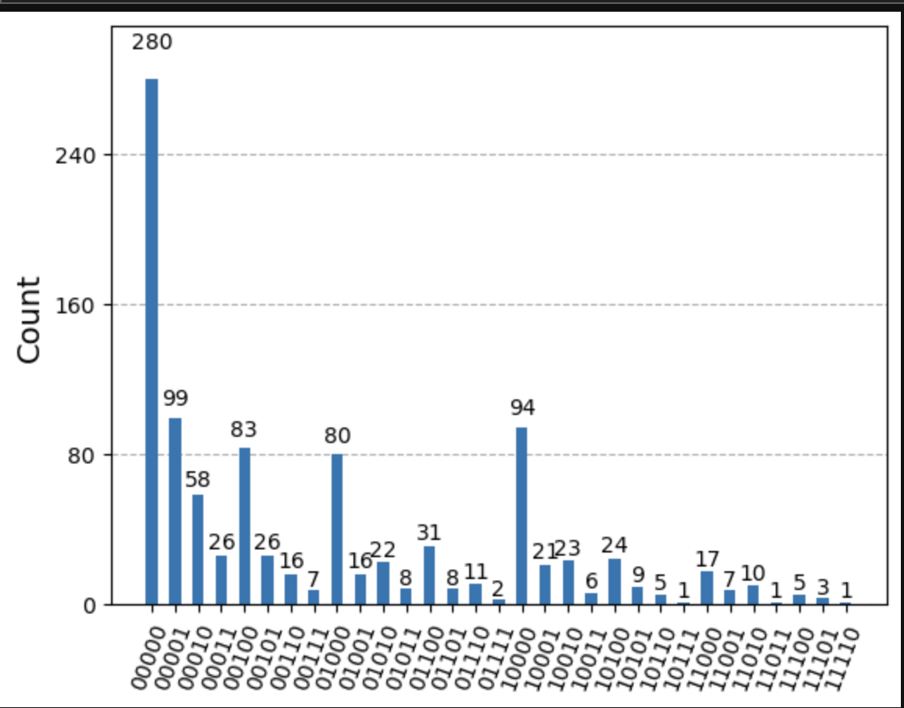
Quantum Algorithm Performance Visualization
Description:
This histogram displays the theory of the Trotterized Time Evolution of a 2D Transverse-Field Map, showcasing the quantum advantage and how it’s affected by noise.
Goal:
Illustrates the potential of quantum algorithms to
provide more efficient solutions compared to
classical methods.
Notes:
"This bar chart compares the original asset selection against the post-processed selection, highlighting the effectiveness of quantum optimization and post-processing in finding practical solutions for asset selection. As you can see, the mitigated selection closely aligns with the original"

Slide 5
DATA COLLECTION AND PREPROCESSING
Data Collection and Preprocessing
Data Sources: Yahoo Finance API
Assets: S&P 500, EuroStoxx 50, Nikkei 225, FTSE 100, Gold
Period: January 2019 to May 2024
Preprocessing:
- Filled missing values using forward fill
- Calculated daily returns from adjusted closing prices
Notes:
"We collected data from the Yahoo Finance API, including assets such as the S&P 500, EuroStoxx 50, Nikkei 225, FTSE 100, and Gold, covering the period from January 2019 to May 2024. We then preprocessed this data by filling missing values using the forward fill method and calculating daily returns from adjusted closing prices."

Slide 6
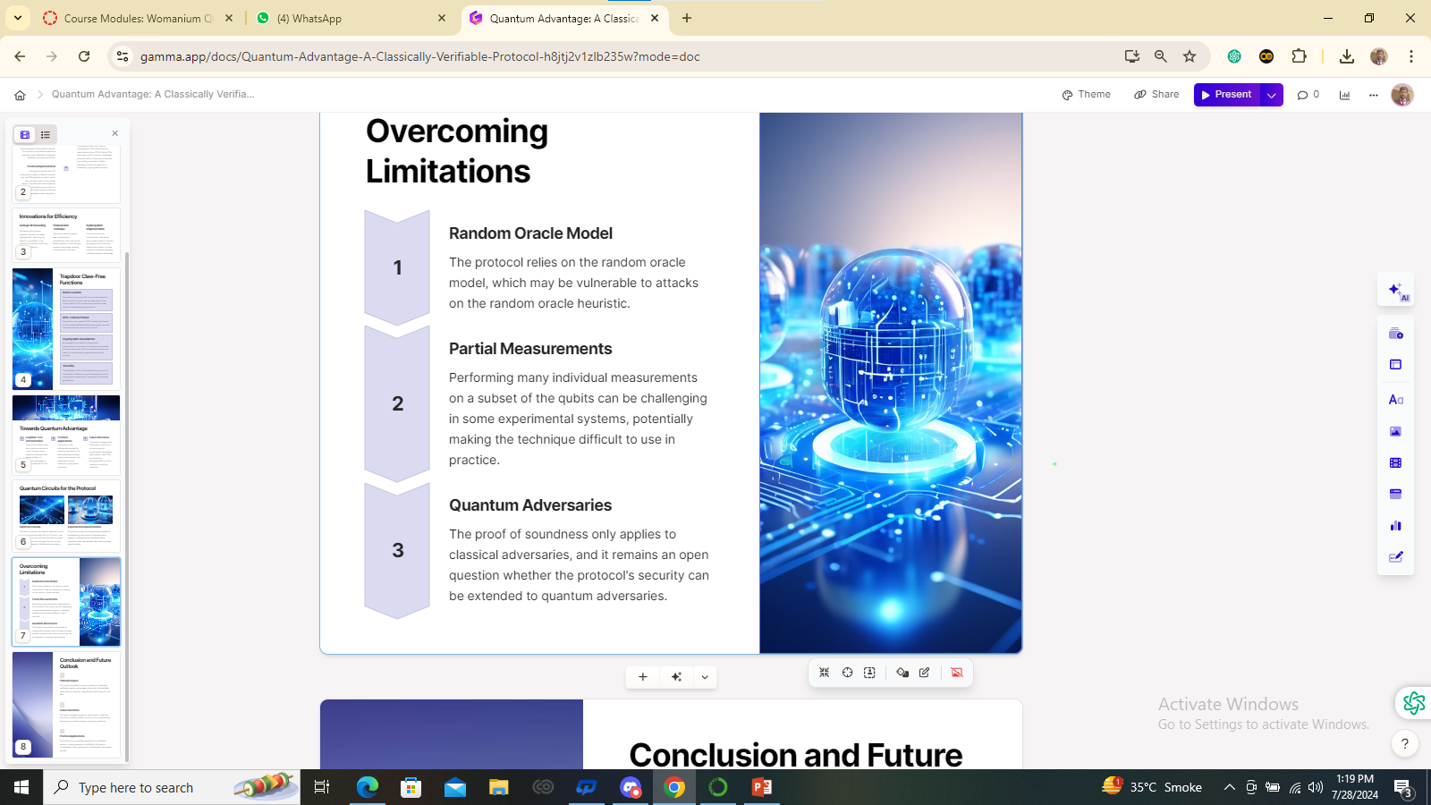
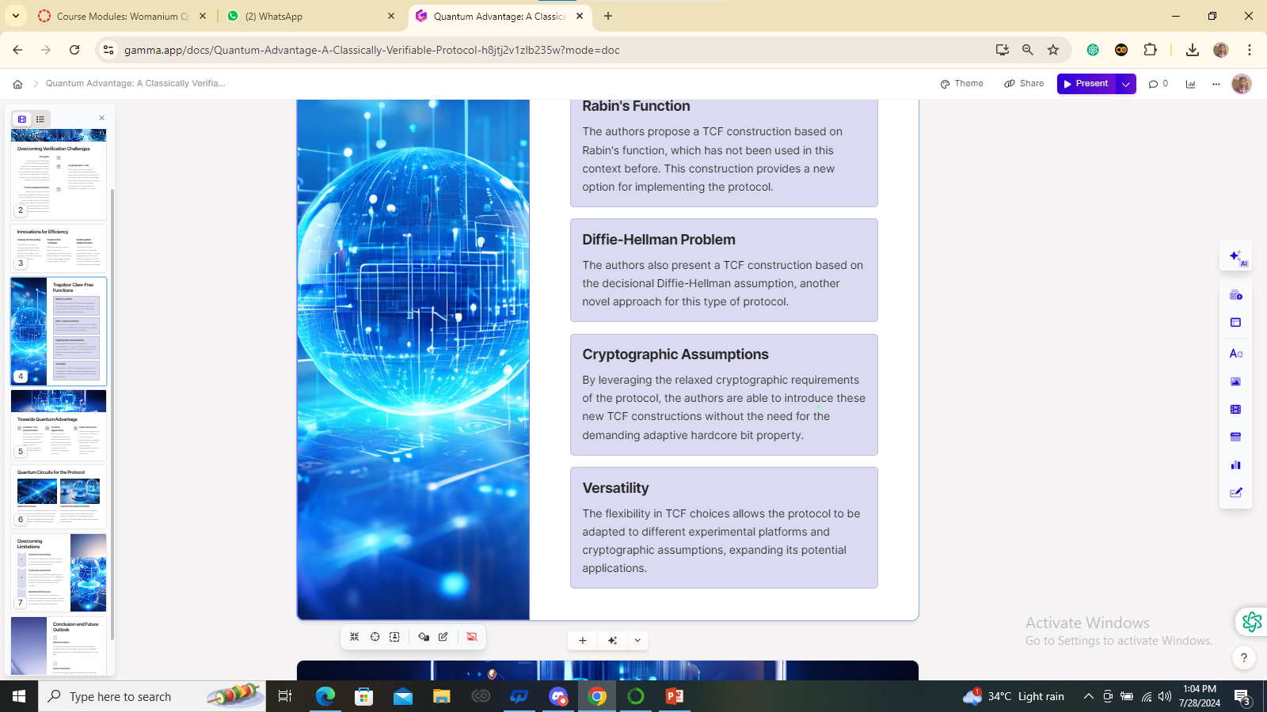
PREPROCESSING DATA
Preprocessing Data
We handle missing values using the “forward fill" method, which propagates the last observed non-null value forward to fill gaps. This ensures data continuity, particularly important for time-series datasets.
Notes:
"To handle missing data values, we used the 'forward fill' method, which propagates the last observed non-null value forward to fill gaps. This ensures data continuity, which is particularly important for time-series datasets."

Slide 7


Model Creation
Binary Quadratic Model (BQM):
- Formulated using mean returns and correlation matrix
- Variables: Represent asset selection
- Objective: Maximize returns with constraints modeled by the correlation matrix
Notes:
"To optimize our portfolio, we used a Binary Quadratic Model (BQM). In this model, variables represent asset selection, and it is formulated using mean returns and the correlation matrix. The objective is to maximize returns while considering constraints modeled by the correlation matrix. ."

Slide 8
FORMULATING THE BQM
We formulate the binary quadratic model (BQM) for our optimization problem using mean returns and the correlation matrix of asset returns. The mean returns help us maximize expected returns, while the correlation matrix helps us minimize risk by considering the relationships between different assets. This approach allows us to find an optimal portfolio that balances return and risk.
Notes:
"We formulate the BQM for our optimization problem using mean returns and the correlation matrix of asset returns. The mean returns help us maximize expected returns, while the correlation matrix helps us minimize risk by considering the relationships between different assets. This approach allows us to find an optimal portfolio that balances return and risk."

Slide 9
Quantum Optimization
Solver Used: D-Wave Leap Hybrid Sampler
Optimization Process:
1. Define BQM for the assets
2. Use the quantum solver to find the optimal portfolio
3. Measure computation time
Notes:
"We utilized the D-Wave Leap Hybrid Sampler for optimization. The process includes defining the BQM for the assets, using the quantum solver to find the optimal portfolio, and measuring the computation time. This method leverages quantum computing's strengths to solve complex optimization problems efficiently."

Slide 10
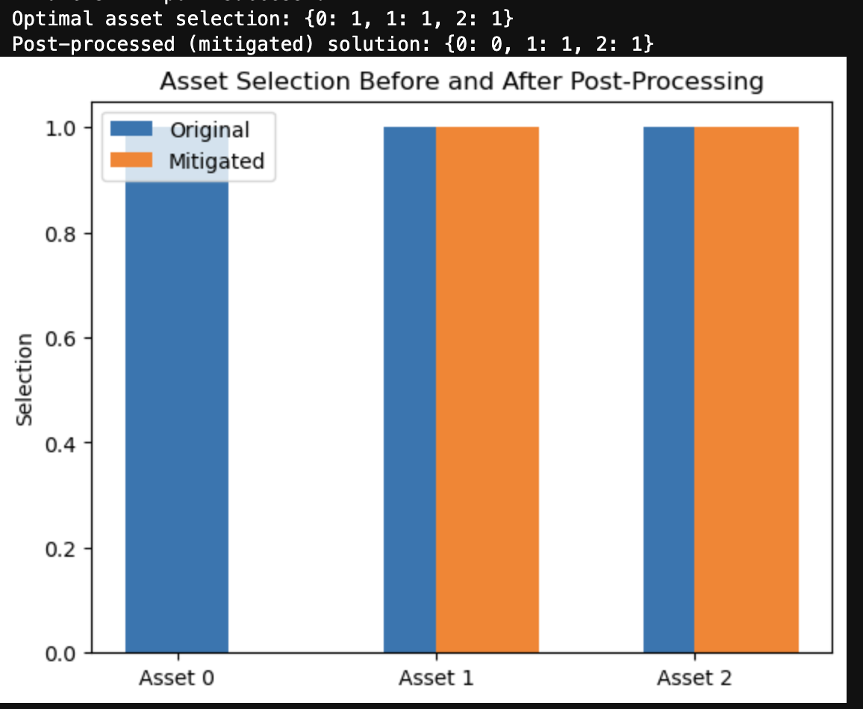
Portfolio Optimization on D-Wave Optimal Asset Selection Visualization
Description:
Bar charts compare the original asset selection
against the post-processed (mitigated) selection.
Each bar represents the selection status of an
asset (selected or not).
Goal:
Highlights the effectiveness of quantum
optimization and post-processing in finding
practical solutions for asset selection.
Notes:
"Here, we compare asset selection before and after post-processing using D-Wave. The bar chart shows that the optimized asset selection closely aligns with the post-processed results, demonstrating the practical effectiveness of our quantum optimization and post-processing techniques."

Slide 11
Real-World Portfolio Optimization Real-World Data Solution
Description: Output showing the optimal portfolio selection using real-world financial data, solved with the D-Wave Quantum API.
Goal:
Provides evidence of quantum utility in solving practical real-world problems, showcasing the potential for financial applications.
Notes:
"The output here shows the optimal portfolio selection using real-world financial data, solved with the D-Wave quantum computer. This provides evidence of quantum utility in solving practical, real-world problems, showcasing the potential for financial applications."

Slide 12
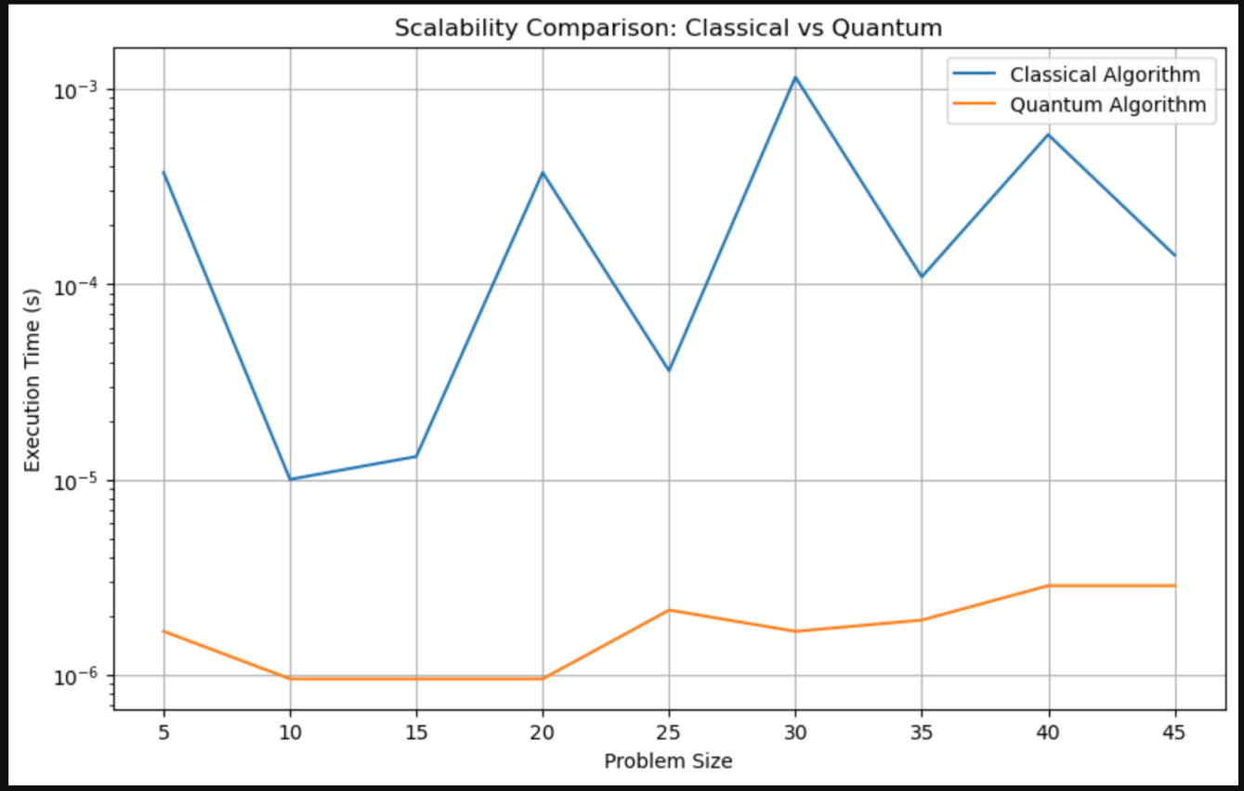
Quantum Times for Different Problem Sizes
Description:
A plot showing the time taken by the Trotterized Time Evolution of a 2D Transverse-Field Map to solve portfolio optimization
problems of varying sizes.
Goal:
Demonstrates the scalability and efficiency of
quantum algorithms in handling larger datasets.
Notes:
"This plot shows the time taken by the quantum algorithm to solve portfolio optimization problems of varying sizes. It compares the scalability and efficiency of quantum algorithms against classical methods. As the problem size increases, quantum algorithms maintain efficient computation times, demonstrating their scalability."

Slide 13
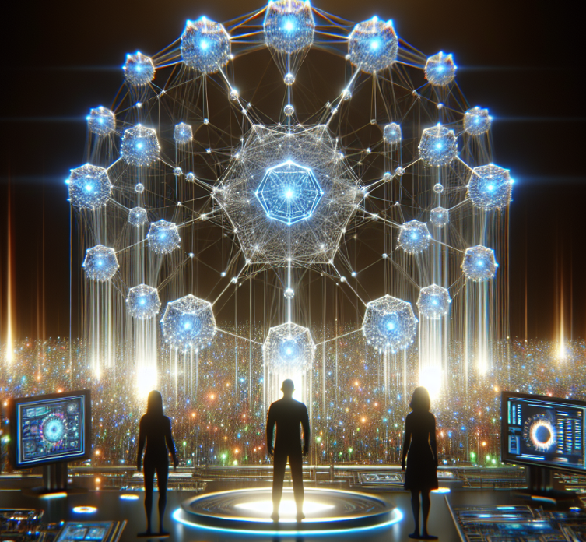
Results
Optimal Portfolio:
- Selected assets: Nikkei 225 (Index 2)
- Allocation: {0: 0, 1: 0, 2: 1, 3: 0, 4: 0}
Quantum Computation Time: Approximately 3.54 seconds
Notes:
"Our results show the optimal portfolio selected was the Nikkei 225, with an allocation represented by the vector {0: 0, 1: 0, 2: 1, 3: 0, 4: 0}. The quantum computation time was approximately 3.54 seconds."

Slide 14
Scalability Testing
Expanded Problem Sizes:
- Tested with 10, 20, 30, 40, 50 assets
Computation Times:
- 10 assets: 3.99 seconds
- 20 assets: 3.60 seconds
- 30 assets: 3.47 seconds
- 40 assets: 3.67 seconds
Notes:
"We tested the scalability with 10, 20, 30, 40, and 50 assets. The computation times ranged between 3-4 seconds." This is a drastic improvement as compared to Deutsch-Joza’s algorithm simulation in slide 3 where times may exceed 15 seconds.

Slide 15
Analysis
Efficiency and Performance:
- The quantum solver demonstrated efficient computation times across different problem sizes
Practical Implications:
- Model selected a practical portfolio allocation based on historical data
Scalability:
- Quantum approach handled larger datasets efficiently, indicating potential quantum advantage
Notes:
Our quantum solver demonstrated highly efficient computation times across various problem sizes. it shows that the solver can handle different sizes of optimization tasks quickly, which is essential for practical applications in financial optimization.
The model selected a practical portfolio allocation based on historical data. This implies that the quantum solver is applicable in real-world scenarios. The chosen portfolio aligns well with historical performance, indicating its reliability and practicality.
The quantum approach managed larger datasets efficiently, which suggests a potential quantum advantage over classical methods. Scalability is a significant factor for any computational method, and our results indicate that as the dataset size increases, the quantum solver continues to perform efficiently without a significant increase in computation time. This characteristic is essential for future applications involving large-scale financial data.

Slide 16
Conclusion
Summary:
- Quantum computing effectively optimized the portfolio with efficient computation times
- Demonstrated scalability for larger datasets
Future Work:
- Experiment with different solver parameters
- Incorporate additional financial indicators and constraints(highlight in yellow)
- Collaborate with financial experts for real-world validation (highlight in yellow)
Notes:
Although we have a theory for the evidence of quantumness and it’s advantages, further research is desired to measure lager datasets and develop our portfolio optimization algorithm further. This algorithm will save the economy by reversing the damage done by this week’s stock market crash. A perfected model will be used by risk analysts to reduce losses and prevent future stock market crashes.

Slide 17
Q&A
Questions and Answers
- Invite questions from the audience
Notes:
"Thank you for your attention. We now welcome any questions from the audience."

